Slide 1
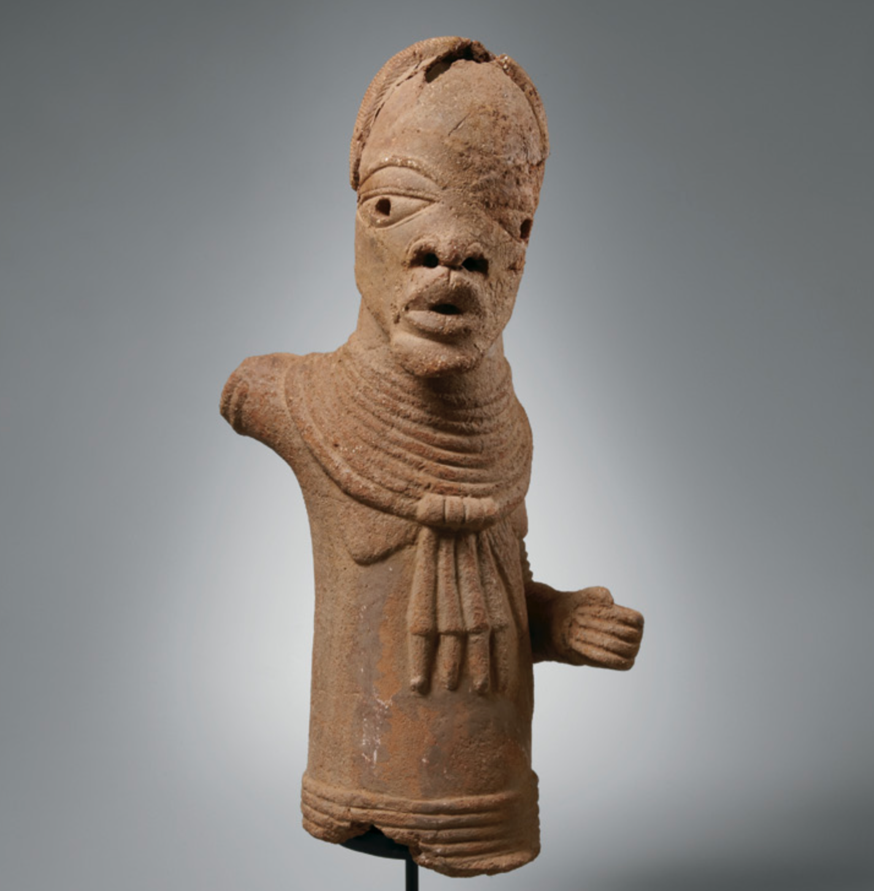
Notes:
A Nok figure. (Nok is pronounced “knock”)

Slide 2
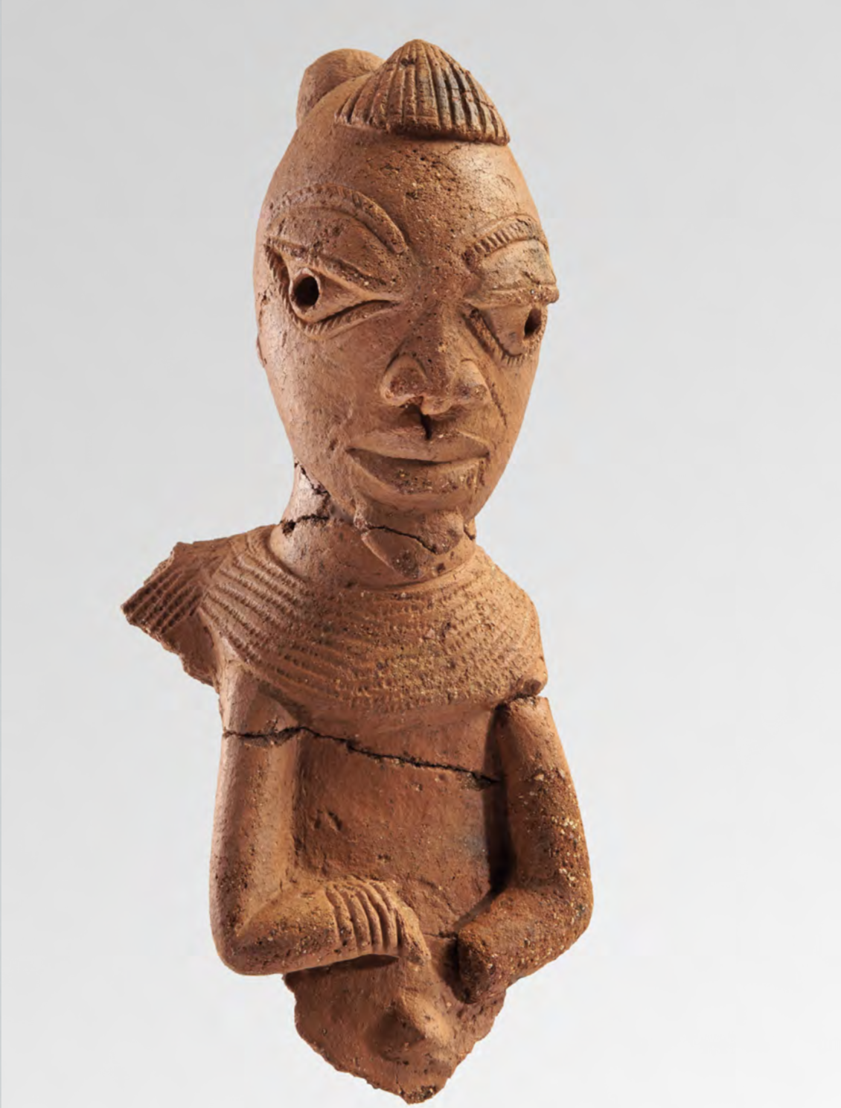
Notes:
Another Nok figure.

Slide 3
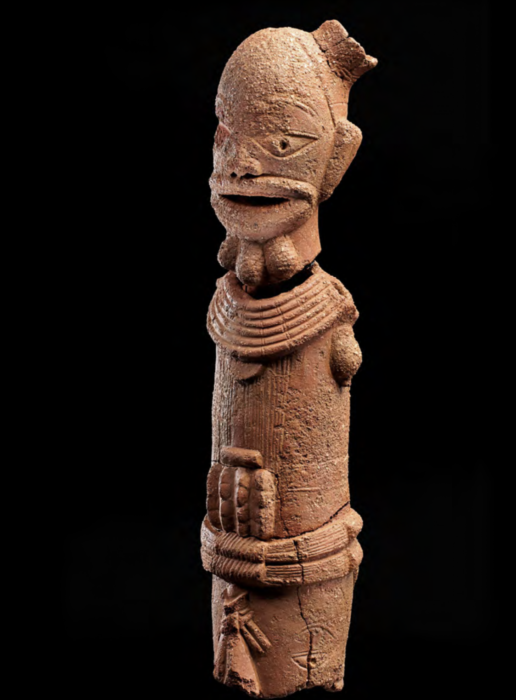
Notes:
Another Nok figure. Notice the detail. Imagine how difficult it would have been to form this out of clay.

Slide 4
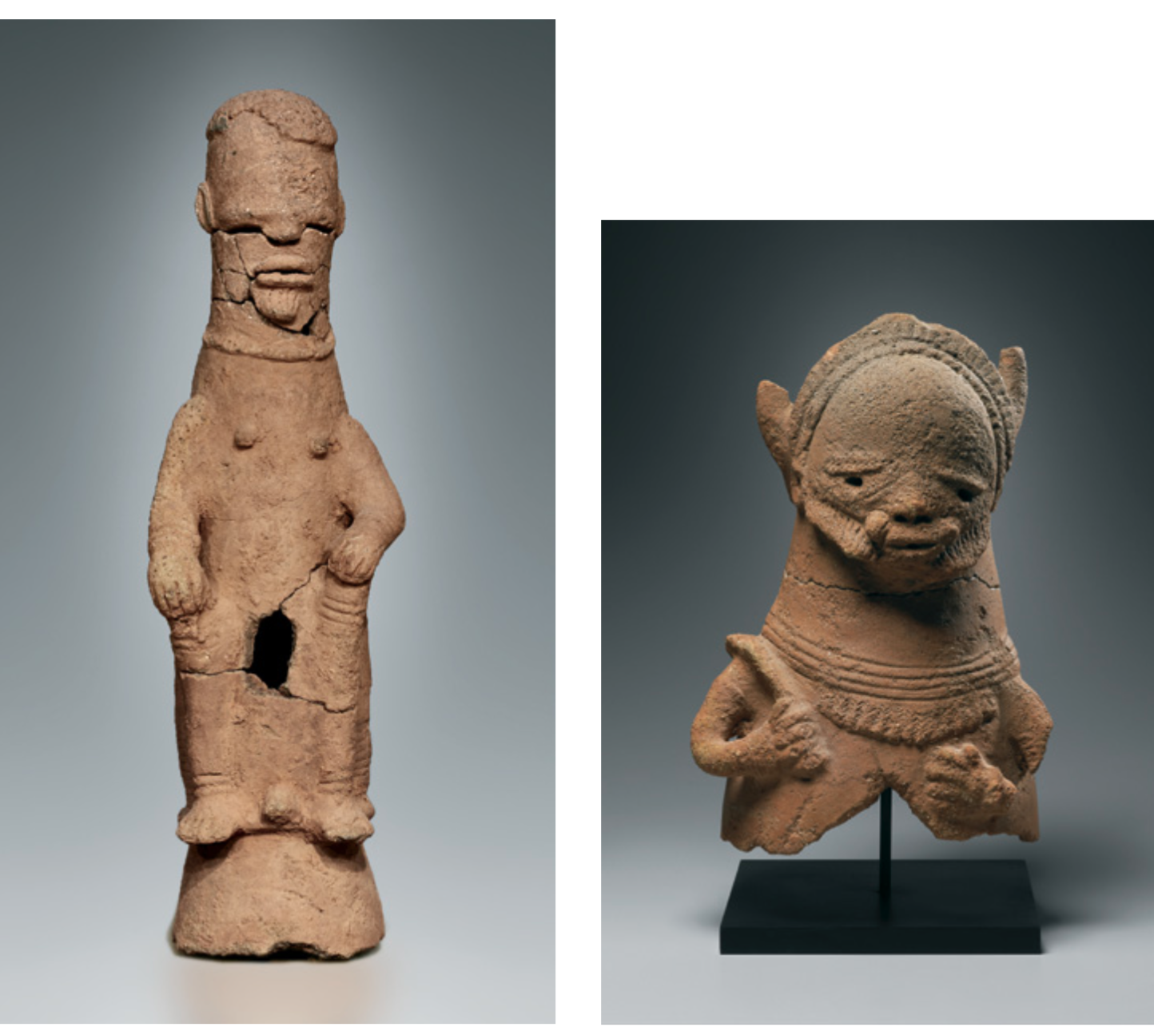
Notes:
Two more Nok figures.

Slide 5
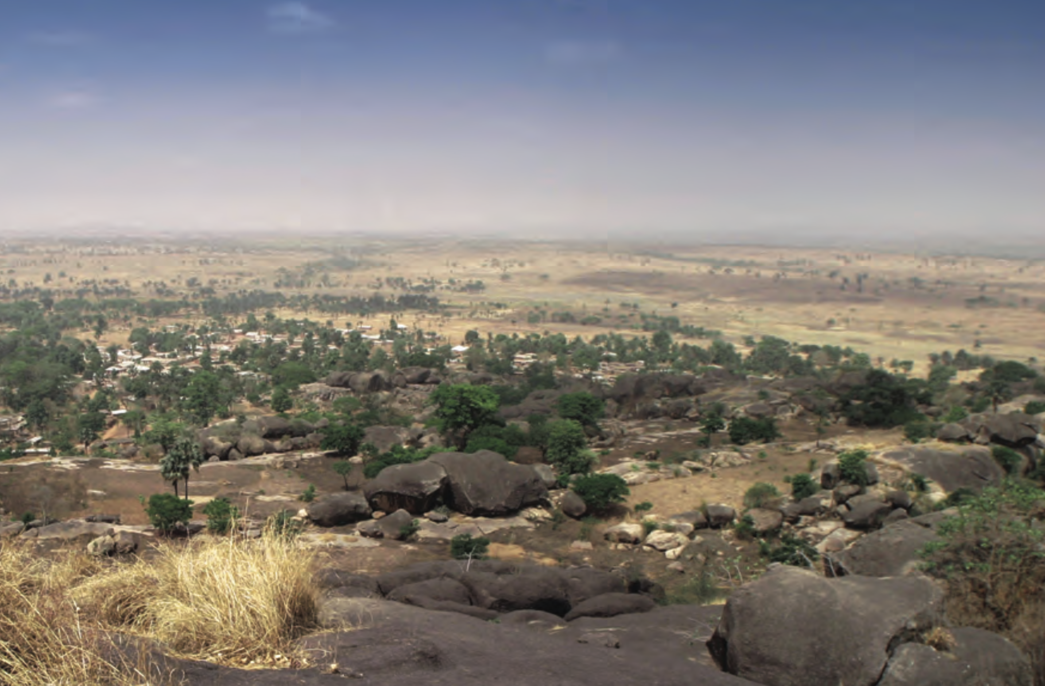
Notes:
This is overlooking the village of Nok in modern day Nigeria. This is where the first terracotta sculptures made by the Nok people were found.

Slide 6
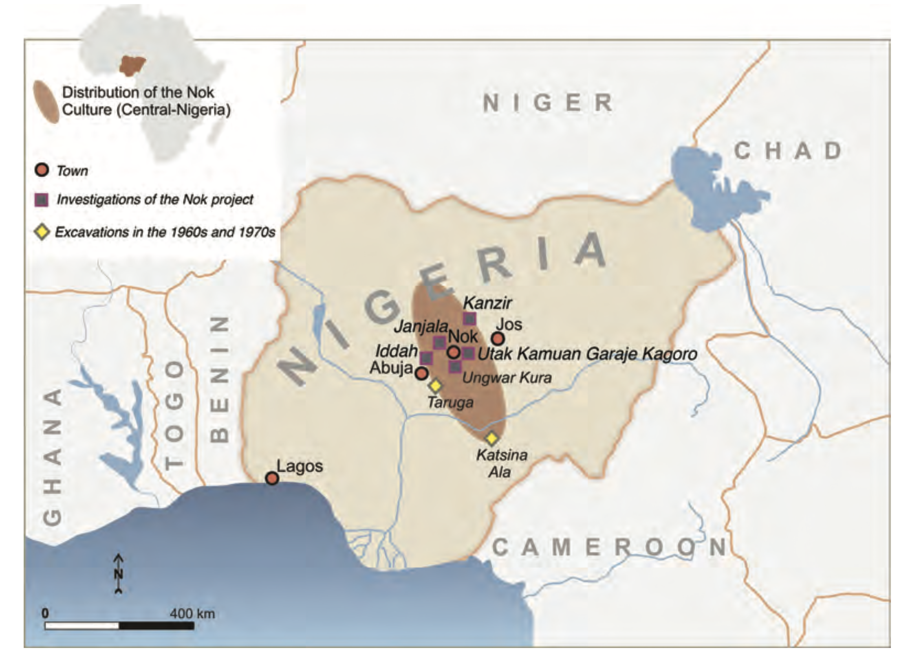
Notes:
This is a map showing the location of Nok within Nigeria and Africa.

Slide 7
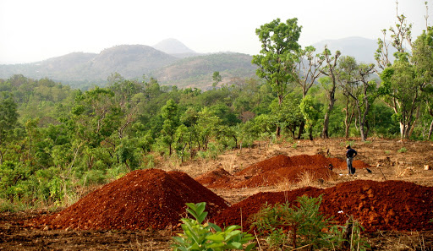
Notes:
This is the farmland where some of the Nok terracotta were discovered.

Slide 8
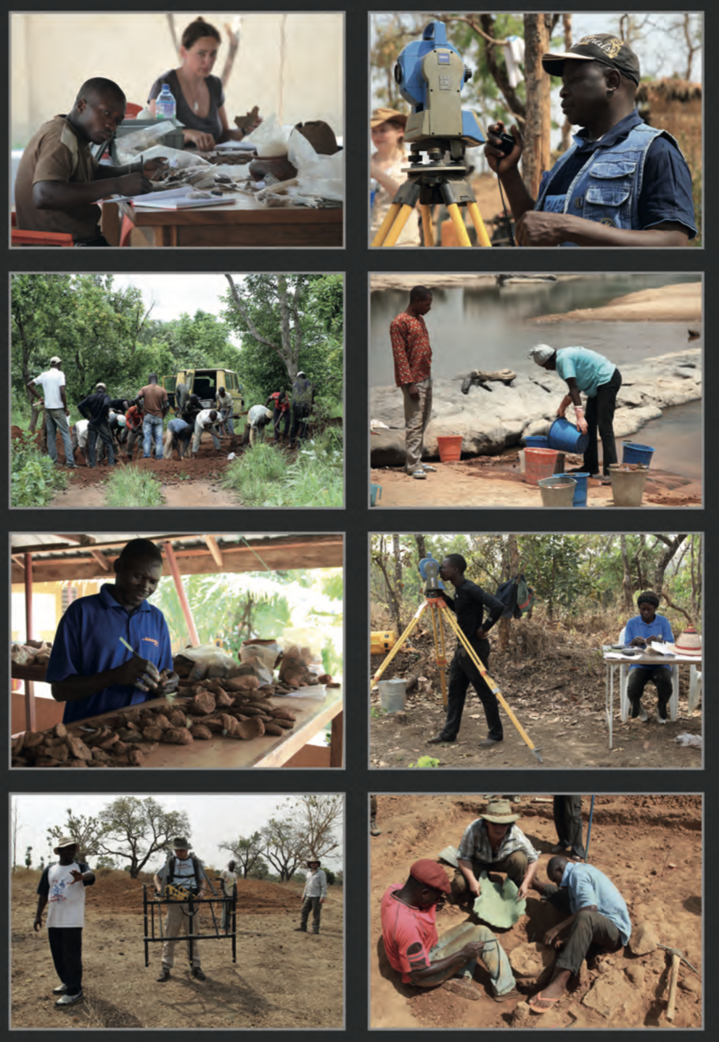
Notes:
These are images of the archeologists who excavated a site of Nok terracotta sculptures. The first step is to map out the area, so it can be recorded where artifacts are found. Notice the surveying tools they use to map out the area.

Slide 9
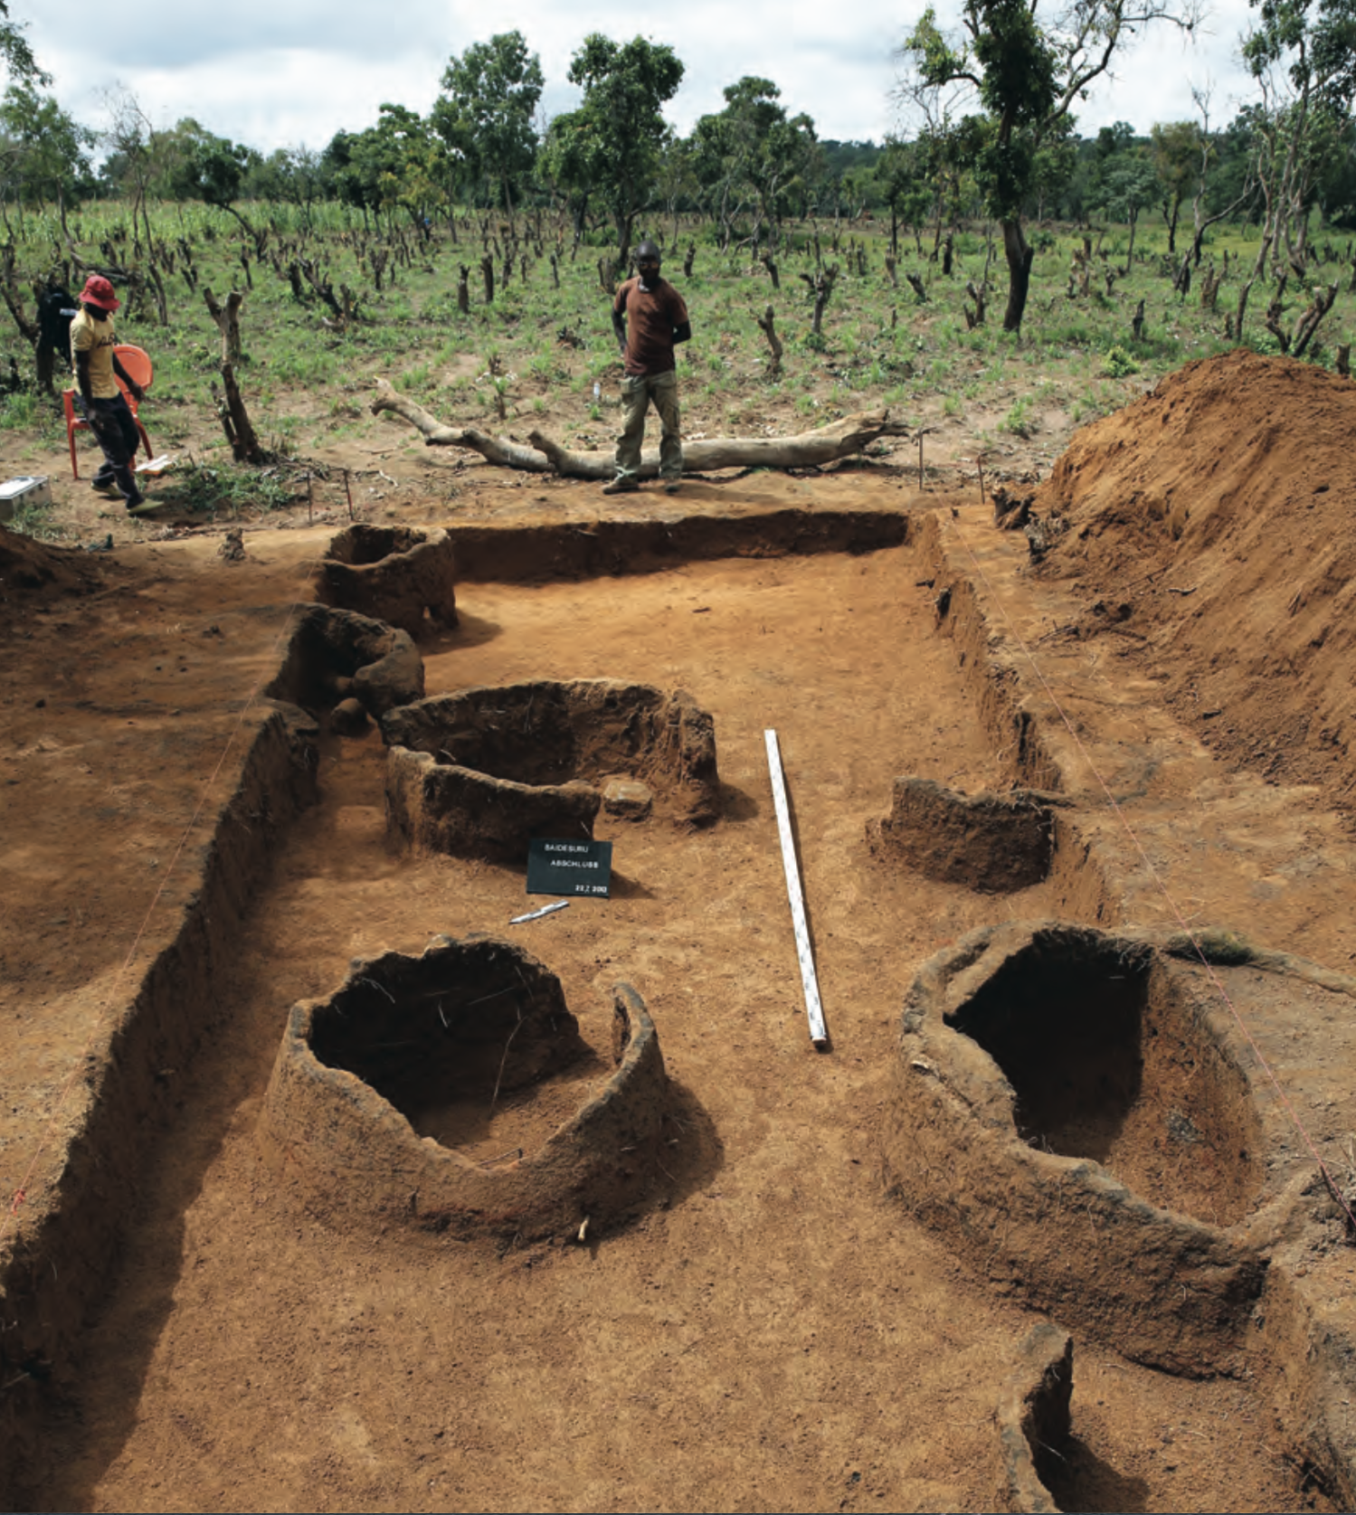
Notes:
Next archeologists use stakes and rope to outline a square. They then carefully dig down into the ground about an inch at a time around the items and avoid disturbing them.

Slide 10
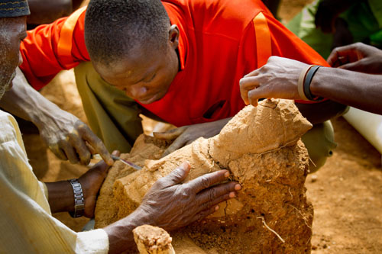
Notes:
Then archeologists carefully clean dirt away from around the artifact.

Slide 11
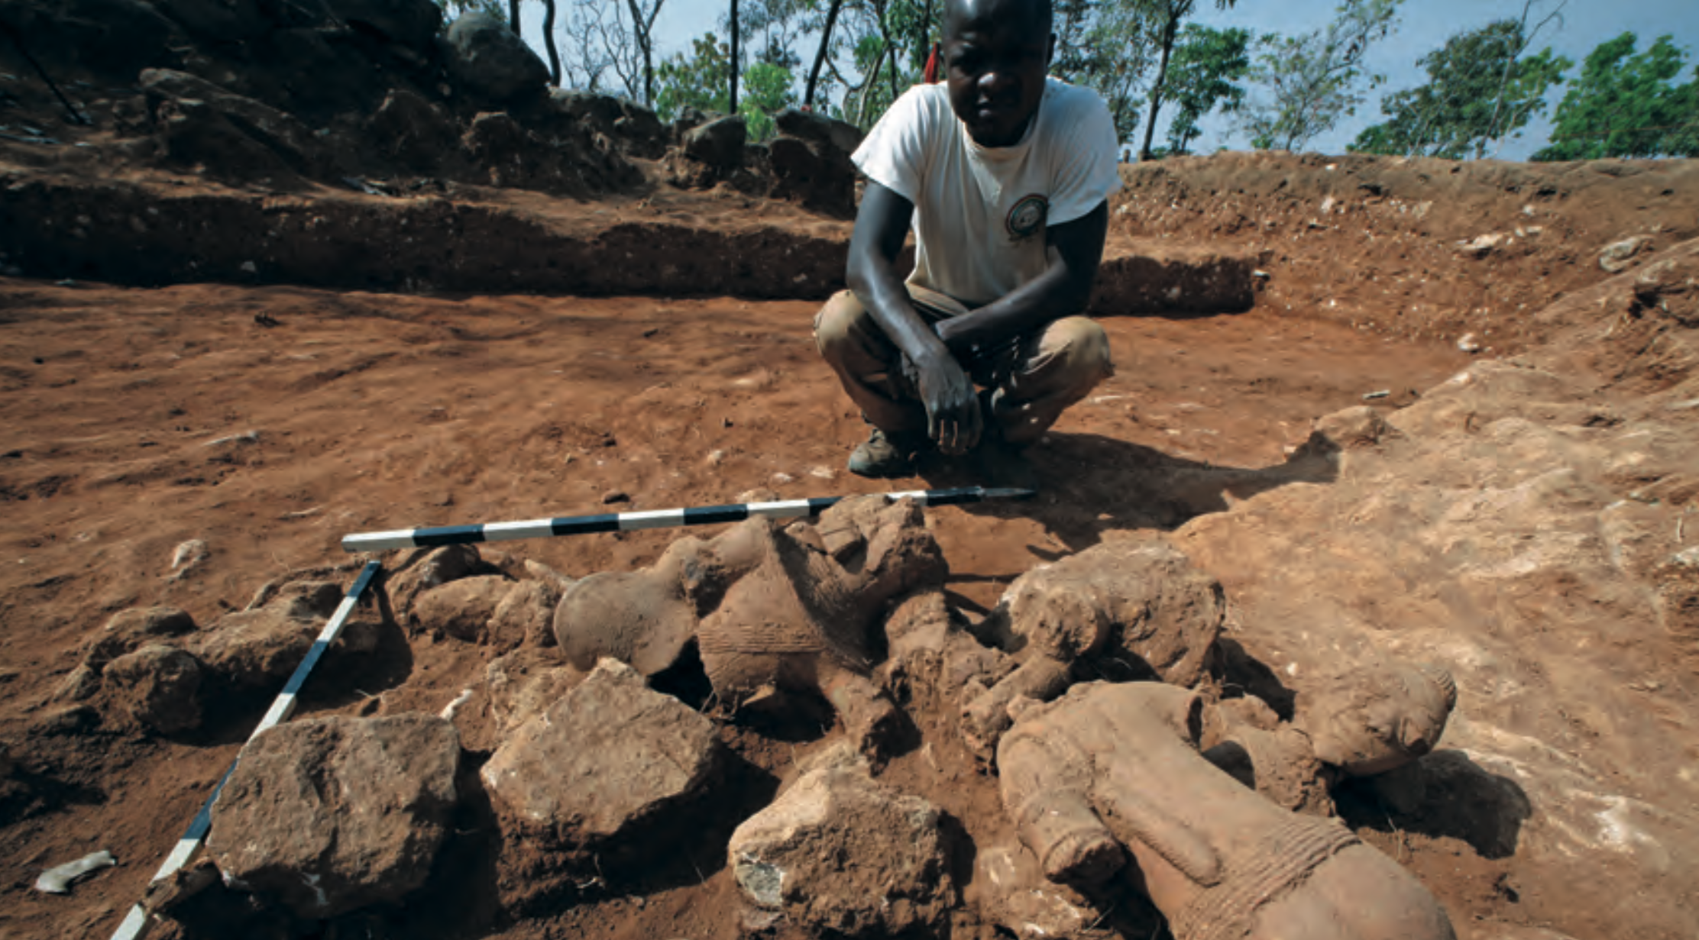
Notes:
Then archeologists measure the artifacts while still in the ground.

Slide 12
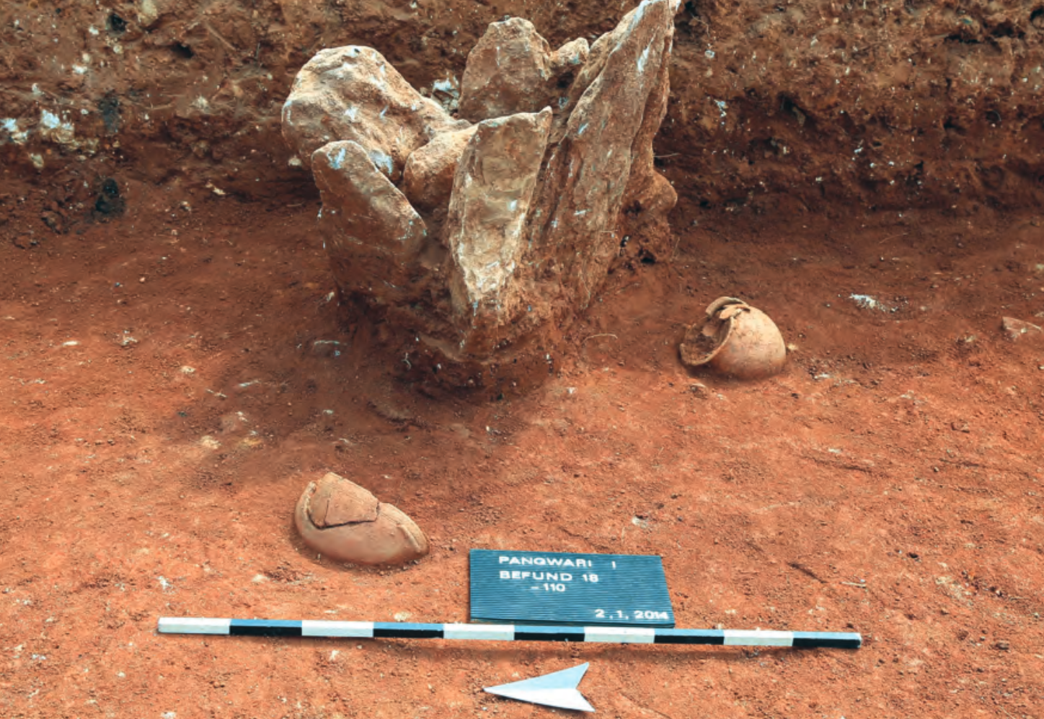
Notes:
Then archeologists then take pictures of the artifacts and label them while they are still in their original location.

Slide 13
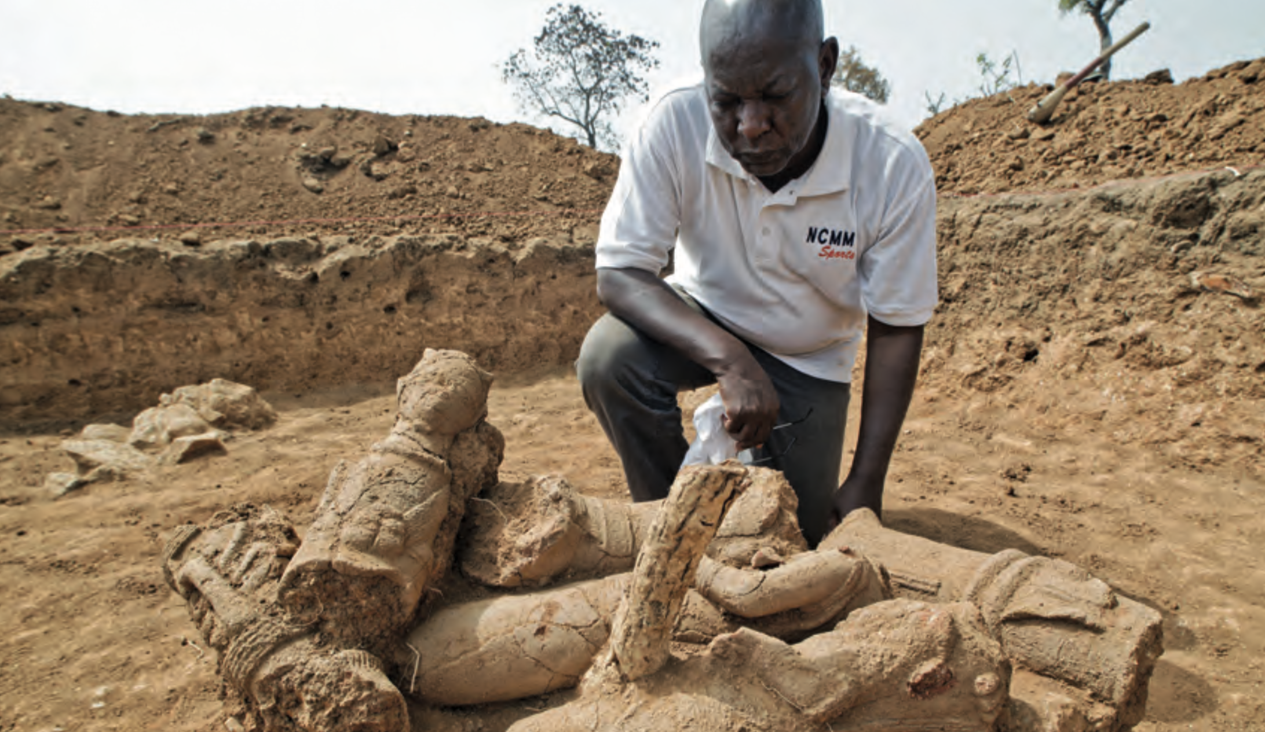
Notes:
Here is an archeologist examining the Nok terracotta sculptures before they are removed and stored for protection.

Slide 14

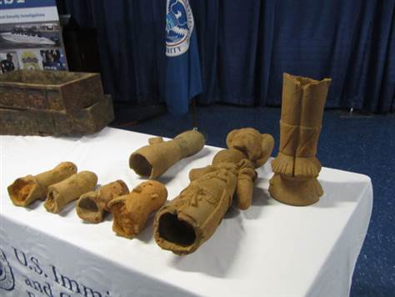
Notes:
Many people have tried to steal the Nok terracotta. In 2012, U.S. Customs Agents prevented some from being smuggled into the United States.

Slide 15
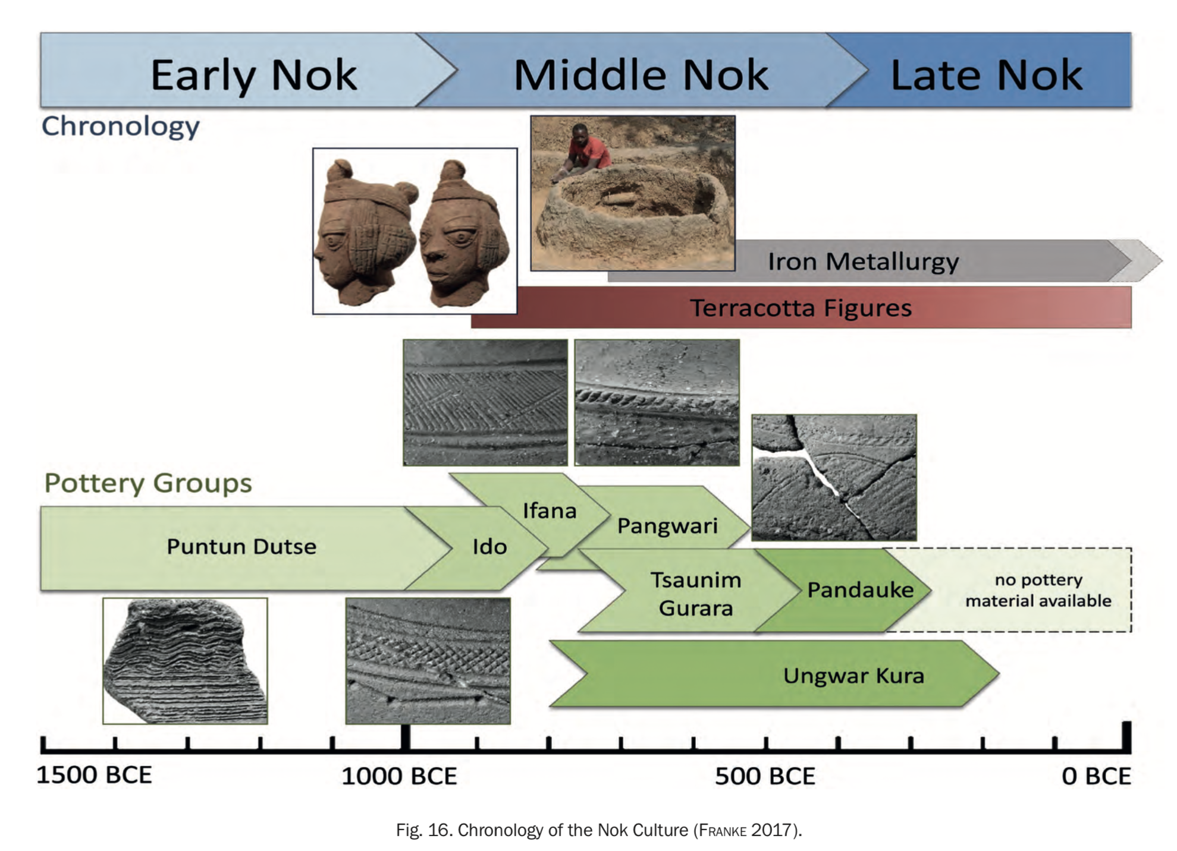
Notes:
Here is a timeline of when the Nok terracotta were created.

